Slide 1
EXPLORATORY DATA ANALYSIS (EDA) GO TO COLLEGE
Kevin
Muhammad Tauhid

Slide 2
agenda
1. Data Overview
2. Background of Business Problem
3. Data Collected Profile
4. Data Mapping
5. Insights and Recommendation
6. Review and Conclusion

Slide 3

overview
DATA COLLECTION: https://www.kaggle.com/datasets/saddamazyazy/go-to-college-dataset by Saddam Sinatrya Jalu Mukti | OUR POSITION As Consultant Team providing insights and recommendations to our client
OUR CLIENT Private University or Educational Institution that need insights to formulate their marketing strategies | OUR GOALS To provide finest quality of insights from past students’ data collected

Slide 4


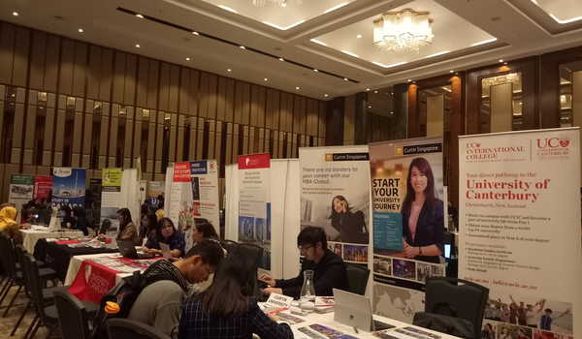

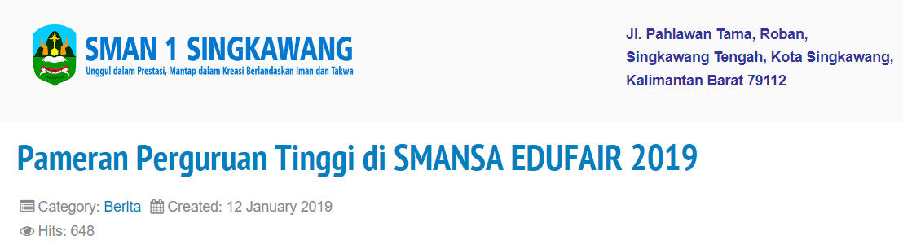
BACKGROUND
OFFLINE | ONLINE

Slide 5
DATA COLLECTED
Drop Column = House Area
School Type Academic (SMA/SMU/MA) and Vocational (SMK) | School Accreditation A and B
Gender Male and Female | Interest (5-Point Likert Scale)
Residence Urban and Rural | Parent Parent Age, Parent Salary, and Was/Wasn’t in College
Average Grades | DECISION Go to College or Not Go to College
1 | 2 | 3 | 4 | 5
Not Interested | Less Interested | Uncertain | Quiet Interested | Very Interested

Slide 6
Data mapping
Gender ⚥ ♀ ♂ 489 515 | Go to College ? ✔ ❌ 500 500 | Go to College by Gender ✔ ❌ ♀ ♂ ♀ ♂ 251 249 234 266
RESIDENCE 🏟 🍀 539 461 |  | Go to College by Residence 🏟 🍀 ✔ ❌ ✔ ❌ 271 268 229 232
5-Point Likert Scale |  | Expectation vs Reality ☹ 🙁 😐 🙂 😄 ✔ ❌ ✔ ❌ ✔ ❌ ✔ ❌ ✔ ❌ 46 40 87 142 158 103 19 81 190 134

Slide 7
Data mapping
School Type 📖 🛠 391 | School Accreditation A B A B 288 321 193 198 | School Type 📖 🛠 391 A B A B 288 321 193 198
Go to College Average Grades 87.80 | Not Go to College Average Grades 84.39 | Aggregate Average Grades 86.10
Go to College Parents’ Average Salary 6,046,040 | Not Go to College Parents’ Average Salary 4,717,100 | Aggregate Parents’ Average Salary 5,318,570
Go to College Avg. 5-Point Likert Scale 3.44 | Not Go to College Avg. 5-Point Likert Scale 3.25 | Aggregate Avg. 5-Point Likert Scale 3.35

Slide 8
Data mapping
Parent was in College ? ✔ ❌ 520 480 | Kids go to College ? ✔ ❌ 500 500 | Parents Education on Kids’ Decision ✔ ❌ ✔ ❌ ✔ ❌ 272 248 228 252
Go to College Average Parents’ Age 52.36 | Not Go to College Average Parents’ Age 52.09 | Aggregate Average Parents’ Age 52.21

Slide 9
INSIGHTS AND RECOMMENDATION
No. | INSIGHTS | RECOMMENDATION
1 | No relationship between gender and decision to go to college. | No need to promote specifically in All-Boys or All-Girl High Schools or adjust promotion contents to either one of them two. Reference: “The Gender Impact on Interest in Continuing Study at Mathematics Education of University of Singaperbangsa Karawang” Paper by Adirakisiwi, A.G and Warmi, A. (2019)
2 | Student lives in urban area that decided to go to college were 8% higher than student lives in rural area. | Since the difference is below 10%, we recommend to do offline promotion more in urban area since offline promotion in rural area requires extra cost for transportation and accommodation. Instead, do more online promotion for student in rural area.
3 | College Interest Survey result can not predict and depicts students’ decision to going into college or not. | Search for more reliable questionnaire source, and use even-number Likert scale so we could eliminate uncertainty of respondents’ opinion. Reference: “Evidence-Based Survey Design: The Use of a Midpoint on the Likert Scale” Paper by S. Y. Chyung, et. Al (2017)

Slide 10
INSIGHTS AND RECOMMENDATION
No. | INSIGHTS | RECOMMENDATION
4 | Go-to college students have higher academic grade above the average students, while student not-going-to college have lower grades below average students. | If Client faced with 2 or more choices of schools, prioritize more on school that produced higher average grades per students than the lower one. Could be refer to: Laporan Hasil Ujian Nasional Website https://hasilun.puspendik.kemdikbud.go.id/#2019!sma!capaian!01&99&999!T&T&T&T&1&!2!&
5 | Parents whose kids entered college have higher average salary above the average, while students not-going-to college have lower parents’ average salary. | If Client faced with 2 or more choices of schools, prioritize more on school that have higher tuition fee than the other choices. Reference: “Hubungan Antara Status Sosial Ekonomi Orang Tua dengan Minat Siswa Untuk Melanjutkan Studi ke Perguruan Tinggi” Paper by Caecilia Dyah Retna Harimurti (2007)

Slide 11
INSIGHTS AND RECOMMENDATION
No. | INSIGHTS | RECOMMENDATION
6 | Parents’ went to college have 8% higher chance for their kids to continue to college than parents’ that not went to college. | If Client faced with 2 or more choices of schools, prioritize more on school that located in area with higher education rate than the lower one. Could be refer to: Tingkat Penyelesaian Pendidikan Menurut Jenjang Pendidikan dan Provinsi https://www.bps.go.id/indicator/28/1980/1/tingkat-penyelesaian-pendidikan-menurut-jenjang-pendidikan-dan-provinsi.html
7 | Average parents for all students (including kids going to college and not, individually) are in around 52 years old. | People around 52 y.o. categorized as gen. x (Binus Online Learning) and shape your marketing campaign around it since parents are our Client’s real customer. Reference for marketing strategy: https://www.forbes.com/sites/forbesagencycouncil/2021/05/12/three-tips-for-marketing-to-generation-x/?sh=526e0f827cf9

Slide 12
INSIGHTS AND RECOMMENDATION
No. | INSIGHTS | RECOMMENDATION
8 | Academic School (SMA/SMU/MA) have higher average academic grades than vocational school | In regards with academic grades which students went to college tends to having higher grades than average students, prioritize promoting on academic school (total number of students are higher as well)
9 | Vocational School (SMK) students are backed with parents with higher average salary than academic school students | In regards with academic grades which students went to college tends to having parents with higher average salary than average students, consider on promoting to vocational school as well (not totally disregarded this school type)

Slide 13
REVIEW AND CONCLUSION
1. Do not neglect basic qualities needed in being a good university, such as relationship with labor market, facilities, teachers’ and academic reputation, and many more (reference: “Factors Influencing the Selection of a University by High School Students” paper by Parivash Jafari and Abdollah Aliesmaili (2013))
2. Offline promotion for school in urban area, online promotion for school in rural area
3. Prioritize school in higher education rate area, higher tuition fee and higher academic grade produced
4. Shape marketing strategies and campaign for Gen. X / Baby Boomers
5. Formulate and perform more reliable survey method or questionnaire questions with even-number Likert scale (scale of 4 or 6)

